Slide 1
Risk Management
Sanket Shrestha

Slide 2
Risk Management
Risk management implies proactively identifying, analyzing, planning, tracking and controlling the risks so as to reduce the probability and the impact associated with the risk.
Risk management is concerned with identifying risks which may affect the project and planning to ensure that these risks do not develop into major threats

Slide 3
Contd…
A risk is a probability that some adverse circumstance will occur
Project risks affect schedule or resources.eg.loss of experienced designer
Product risks affect the quality or performance of the software being developed. e.g. failure of purchased component to perform an expected.
Business risks affect the organisation developing or procuring the software.e.g,a competitor introducing a new product is a business risk.

Slide 4
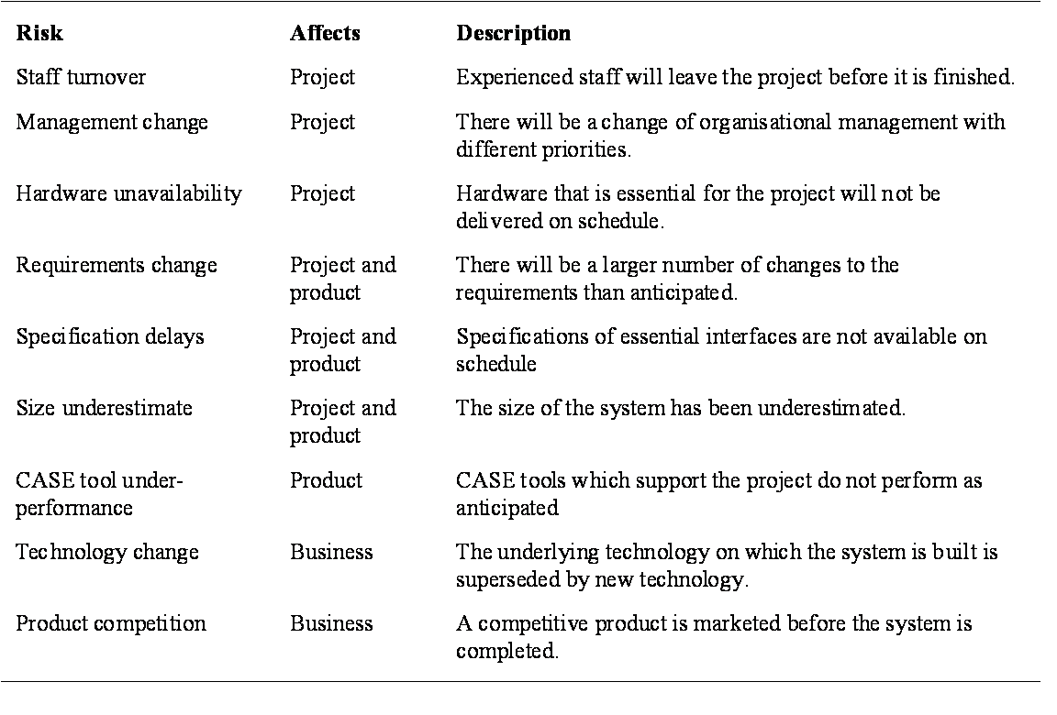
Example of some risks

Slide 5
Risk management process:
Risk identification
Identify project, product and business risks;
Risk analysis
Assess the likelihood and consequences of these risks;
Risk planning
Draw up plans to avoid or minimise the effects of the risk;
Risk monitoring
Monitor the risks throughout the project;
The risk management process, like other project planning is an iterative process which continues throughout the project. Once an initial set of plans are drawn up, the situation is monitored. As more information about the risks becomes available, the risks have to be reanalyzed and new priorities established. The risk avoidance and contingency plans may be modified as new risk information emerges.

Slide 6
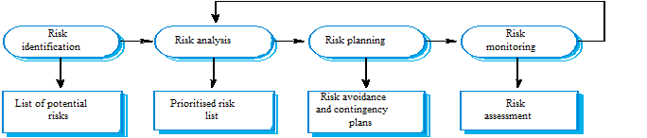
Contd..

Slide 7
Risk identification:
It is the first stage of risk management. It is concerned with discovering possible risks to the project. Risk identification may be carried out as a team process using a brainstorming approach or may simply be based on experience. There are si x types of risk that can arise:
Technology risks.
People risks.
Organisational risks.
Requirements risks.
Estimation risks.

Slide 8
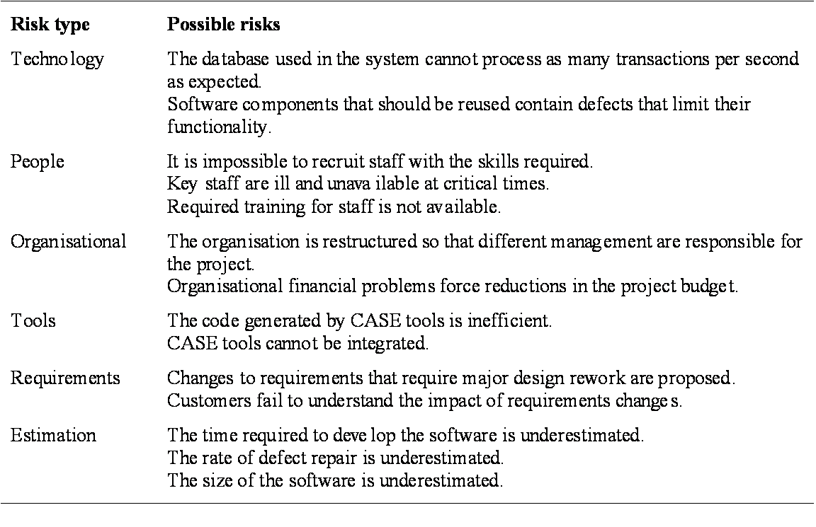
Contd..

Slide 9
Risk Analysis
Once risks are identified, analysis should be performed to determine the following attributes for each risk:
Probability: The likelihood that the risk will occur (High, Medium or Low).
Impact: The impact to the project should the risk occur (High, Medium or Low).
Once these values are identified, each risk should be assigned a Risk Factor using the Ordinal Value Method which is illustrated in figure:

Slide 10
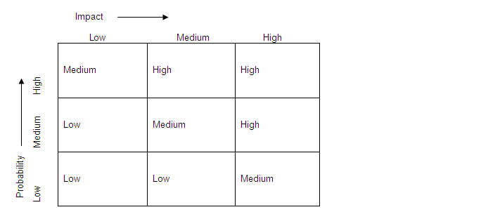
contd..
The risks should be prioritized based on the risk factor.
There may be other risks which are not conceived during the initial planning but may later surface during the project execution. These risks also should be considered as and when they are identified.

Slide 11
Risk Planning
After risks have been identified, the project manager needs to decide which risks are important enough to be included in management planning; as not all risks will warrant planning. Risk management planning depends on availability of resources and risk factors. For each risk that needs to be included in management planning, the following need to be formulated:

Slide 12
Contd…
Mitigation plan
The mitigation plan should be the first recommended course of action with regards to minimizing the occurrence of the risk and should be focused on preventing the situation from ever arising.
Contingency plan
The contingency plan should serve as the backup plan that comes into play when the risk has occurred and the impact to the project needs to be minimized.

Slide 13
Risk Score Assignment
Once all risks are identified and planned for, the project needs to be assigned a risk score using the following equation:
Risk Score = 1 x (Number of Low risk factor risks) + 4 x (Number of Medium risk factor risks) + 10 x (Number of High risk factor risks)

Slide 14
Risk Monitoring and Control
Monitoring involves the status of identified risks, the change in risk factor and the change in the overall risk score of the project.
Any escalation in the risk factor or risk score of the project must be communicated immediately to higher management.
The risk status of the project must be a part of the status reporting. This is dictated by the organizational Project Status Report template.
Control involves the execution of the identified mitigation plans for risk prevention and the execution of contingency plans when risks do occur.

Slide 15
Risk Knowledge Base
The organizational Risk Register serves as the risk knowledge base that documents all organizational level risks and recommended mitigation and contingency plans.
The Risk Register refers to the comprehensive risk management plan drafted by the management for risks related to IT resources, facility and infrastructure.
Project managers are responsible for communicating information that they deem useful for the Risk Register to the management.

Slide 16
Key points
Good project management is essential for project success.
The intangible nature of software causes problems for management.
Managers have diverse roles but their most significant activities are planning, estimating and scheduling.
Planning and estimating are iterative processes which continue throughout the course of a project.
A project milestone is a predictable state where a formal report of progress is presented to management.
Project scheduling involves preparing various graphical representations showing project activities, their durations and staffing.
Risk management is concerned with identifying risks which may affect the project and planning to ensure that these risks do not develop into major threats

Slide 17
Thank You

